Slide 1
Predicting Depression Rates
Ryan Nebblett, Ali Manekia, Chris Cornelius, Ben Pientrancosta, Yessika Zurita
March 15, 2023

Slide 2
Agenda
Problem Statement
Data Overview
Machine Learning Modeling
Dashboard

Slide 3
Machine Learning Modeling Process Overview
Data Preprocessing
Manual feature selection from 2,400 independent variables to 30
Z-score scaling (all numeric)
Reduce multicollinearity through VIF calculation and feature reduction
Linear ML Models for Continuous Variable: OLS, Ridge, LASSO
Non-Linear ML Models for Continuous Variable:
Random Forest Regression on scaled subset of features
Random Forest Regression on entire set of unscaled features

Slide 4
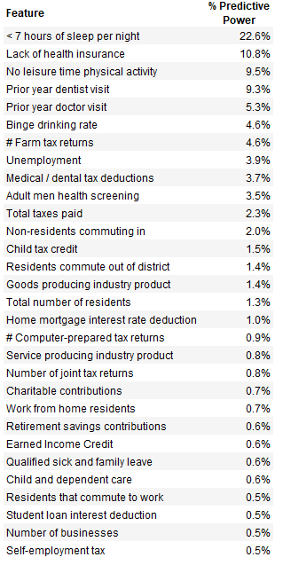
Machine Learning Modeling Results Comparison

